Slide 1

SMART MEDICINE REMINDER

Slide 2
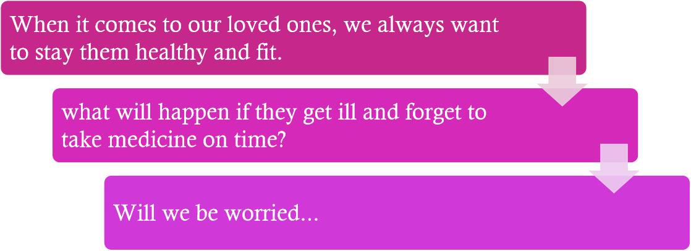
INTRODUCTION

Slide 3
ABSTRACT
This project is a Smart Medicine Reminder (SMR) prototype.
The main purpose of this technique is to assist the patients, primarily seniors, take their medications on time in a simple way without the likelihood of missing pills, also this will reduce the risk of taking over dosage or under dosage.
Not taking medications correctly can have serious consequences like delayed recovery, illness and even death.
The Smart Medicine Reminder could solve such problems by informing and alerting the patients to require the acceptable dose at the proper time before anything happens out of control.

Slide 4

PROBLEM STATEMENT
As pills have taken such an important role in everyday life there has been the past years an increase in the number of medical neglect cases related to incorrect medication given to patients, such as the case of the nurse who gave a patient a paralytic instead of an antacid that was prescribed by the doctor, causing the patient's death. After seeing so many of these cases it is evidently crucial that the correct pill is taken by the correct person at the correct time, otherwise taking an incorrect one or not taking one at all may expose the patient to several dangerous situations, ranging from mild health issues up to death. finally there are situation where taking an incorrect amount of pills is a matter of the patient's inexperience and/or ignorance. no matter the cause, it has been proven that there is a significant risk of people ending up swallowing the incorrect medication or dose.

Slide 5
OBJECTIVES
Our Motivation is to provide a solution to Old-age people who forget to take their medicines ontime which might affect their physical as well as mental health. We are going to send remainders to the person to take their medicine and also a popup message will appear to confirm their status.Like they need to click yes or no, if the reply to message is yes then remainder will appear for next medication if not then the popup message will be appearing for the time interval which we set by this we can know the status of the person. This is a working model of a Smart Medicine Reminder using with arduino which helps patients keep track of their medicine consumption on daily basis and reminds them to take medicines on time and also refill the medicines on weekly basis via an Audio-Visual Stimuli. We are going to develop an app and also implement it practically.

Slide 6
LITERATURE SURVEY
Author | Year Of Publication | Analysis | Conclusion
1. Diaa Salama Abdul Minaam Information Systems Department, Faculty of Computers and Informatics, Benha University, Egypt, Mohamed Abd-ELfattah Information Systems Department, Faculty of Computers and Informatics, Benha University, Egypt. | 2018 | This paper consists on the conception, design and creation of a pillbox prototype intended to solve this deficiency in the medical area as it has the ability of sorting out the pills by itself as well as many other advanced features, with this device being intended to be used by hospitals or retirement homes. | A canny pillbox is proposed and actualized in this paper. It illuminates the elders to take medication. It productively controls the season of senior citizens to take medication. It additionally diminishes the proportion that patient misses and defers taking medication. The remote user interface joins with the RoboRemo software programming so that the parental figures can help the patient. Which adds more functionality by applying more usability through networking locally or using the internet if it is available.

Slide 7
Author | Year Of Publication | Analysis | Conclusion
2.Sanjay Bhati UG Student Department of Electronics & Communication Engineering SAL Institute of Technology & Engineering Research, Ahmedabad | 2017 | Present time will be saved in RTC module and notification time will be saved in EEPROM. Therefore at the time of taking medicine system generate Notification sound and display the Bright light in certain pill boxes. So, patient can know the specific number of box from which he has to take out medicines. All pill boxes are pre-loaded in the system which patient needs to take at given time. And our system has quality that it can sense if the patient had taken out pills from the box or not. | The goal of the project is to provide healthy and tension free life to those users who are taking regularly pills and to provide this product at affordable cost also. This project is useful for those people who are taking pills regularly, prescription of medicine is very long and hard to remember for those users. This project is also reusable by exchanging those other medicine box that has only alerting system and are non-usable or unaffordable compare to their product.

Slide 8
PROPOSED METHODOLOGY
The application of Smart Medicine Reminder is very wide. The Pill Reminder Alarm is powered using 5V supply. When it first boots up, it shows a welcome massage as “Welcome ”.
The screen is set to cycle in three screens. The 1st screen shows message as “Stay Healthy”(we can set any message). The second screen is a help screen which tells to press select push button to select any one time-slot to remind (once/twice/thrice in a day). The time slot is changeable in program and can be configured accordingly. We can also set the time format as 12hours or 24hours.

Slide 9
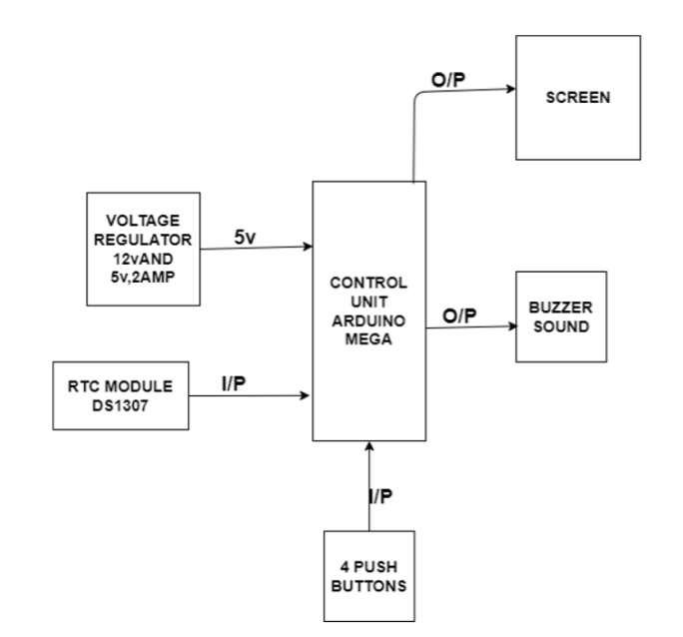
Architecture Diagram:-

Slide 10
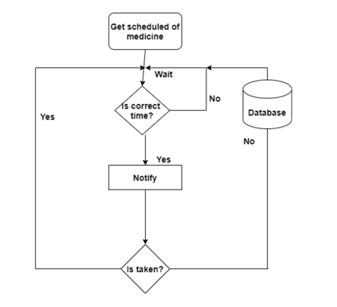
Architecture Diagram for Android APP

Slide 11
MODULES INVOLVED
Software Modules:
The reminder system consists of two parts
Setting alarm
Getting notification

Slide 12
Set alarm module:
It helps in reminding about the medications. User can add details of his dosage schedules. Using the data field one can enter the starting and ending dates between which he has to take medicines. The time field shows the time of dosage and on the time of alarm we will get ring. The user can add the description of the medicine, including name, purpose and other related descriptions. All the information will be saved . This makes anytime availability of the patient’s record. They can also change the ringtone of the alarm from the ringtones stored in the devices
Get notification module:
Once the alarm is set then the user gets the notification. The user can activate or deactivate this accordingly. If he does not require the notification he can turn off it. If he requires this system then a notification will be sent into his device.

Slide 13
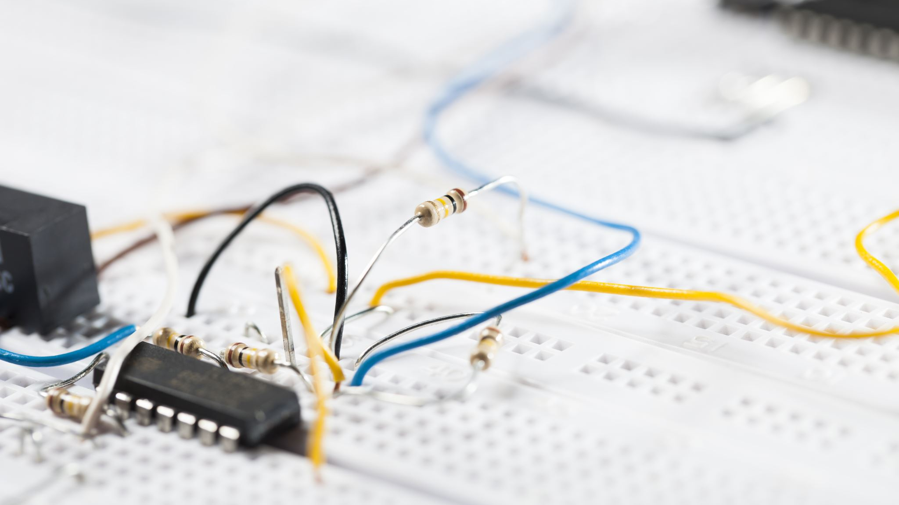
Hardware modules :
RTC DS3231 - For time
A buzzer - To alert and remind that it’s time to take medicine.
The output will be displayed on the Arduino Serial Monitor Screen

Slide 14
REQUIREMENTS
Hardware Components
•Arduino Uno with USB cable –1
•Push Button – 4
•RTC DS3231 module -1
•Resistor 10K - 4
•Jumper Wires (Male to Male) - 20pcs
•Jumper Wires(Male to Female)- 20pcs
•Buzzer B-10 – 1
•Single stand wire 2mt -1
•Breadboard -1
Software Requirements
Arduino IDE - Programmable platform for Arduino
Android Studio - Android App

Slide 15
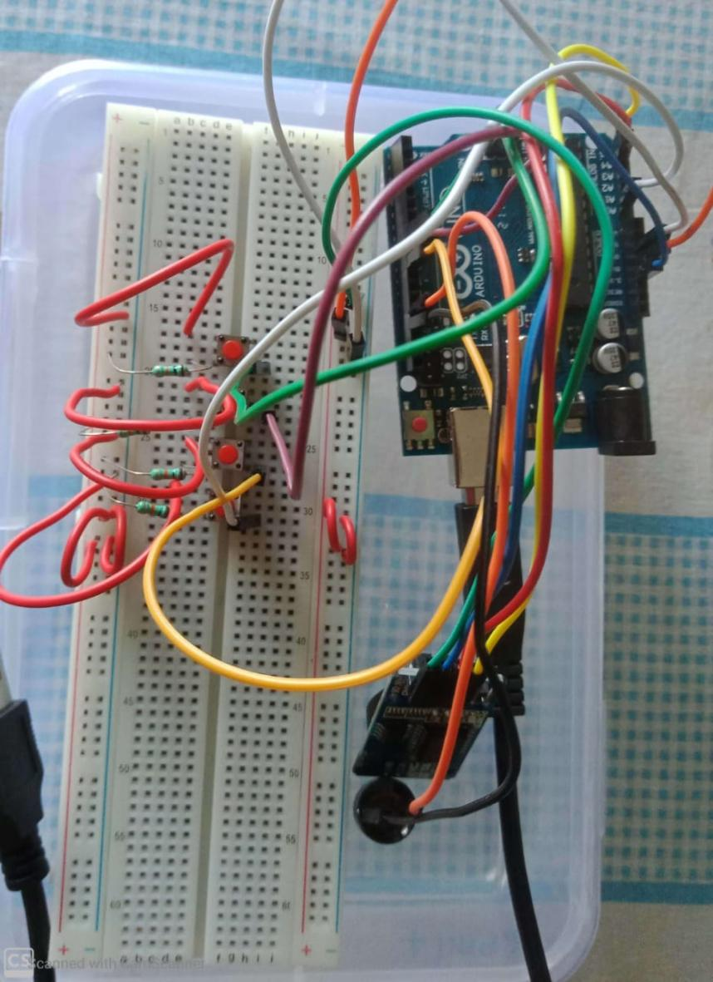
CIRCUIT

Slide 16
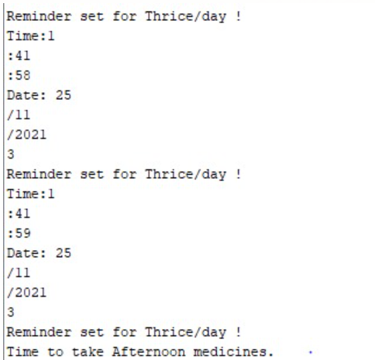
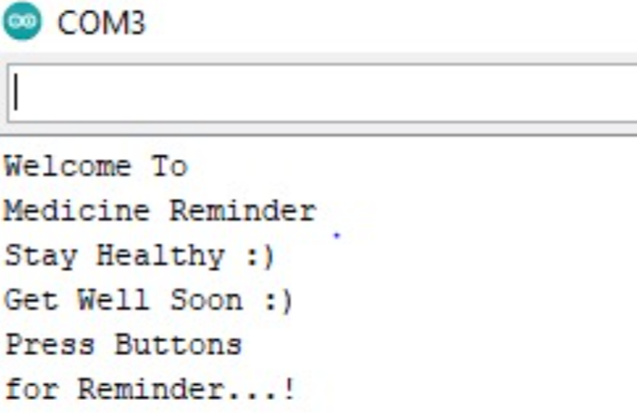
OUTPUT ARDUINO :

Slide 17
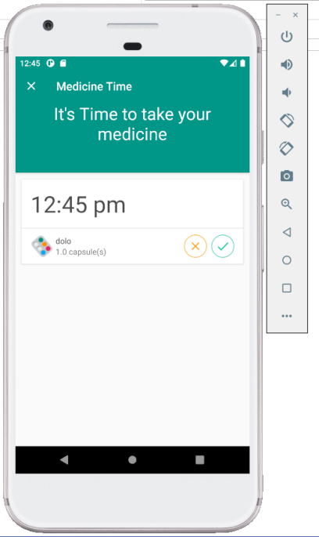
ANDROID APP :

Slide 18

TEAM MEMBERS
Setty Rashmika – 18MIS1049
Kuraparthi Thanmayee-18MIS1076
Papudesi Umapathy Sonia – 18MIS1089
V Chandana Priya – 18MIS1091
Badam Koushil - 18MIS1092

